Slide 1
Practical Record And Replay Debugging With rr
Robert O'Callahan

Slide 2
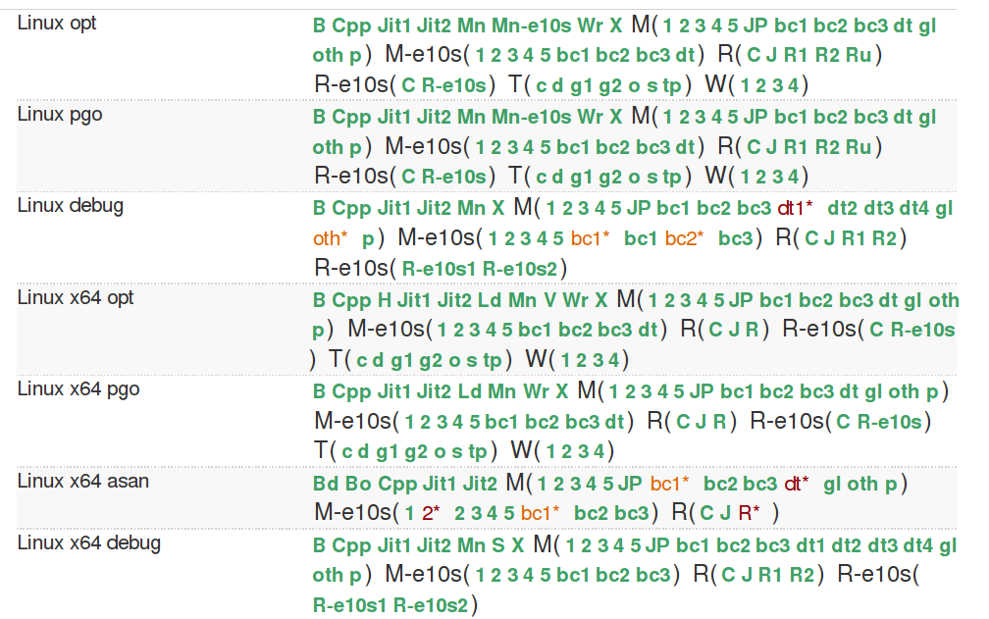
Debugging nondeterminism

Slide 3
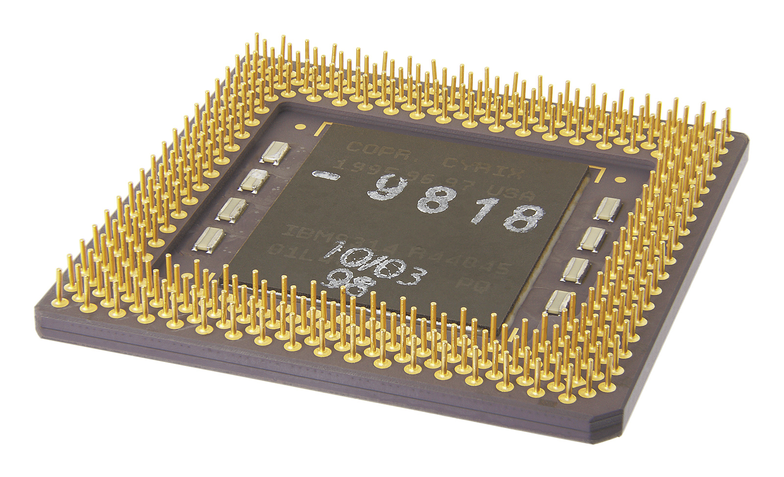

Deterministic hardware

Slide 4
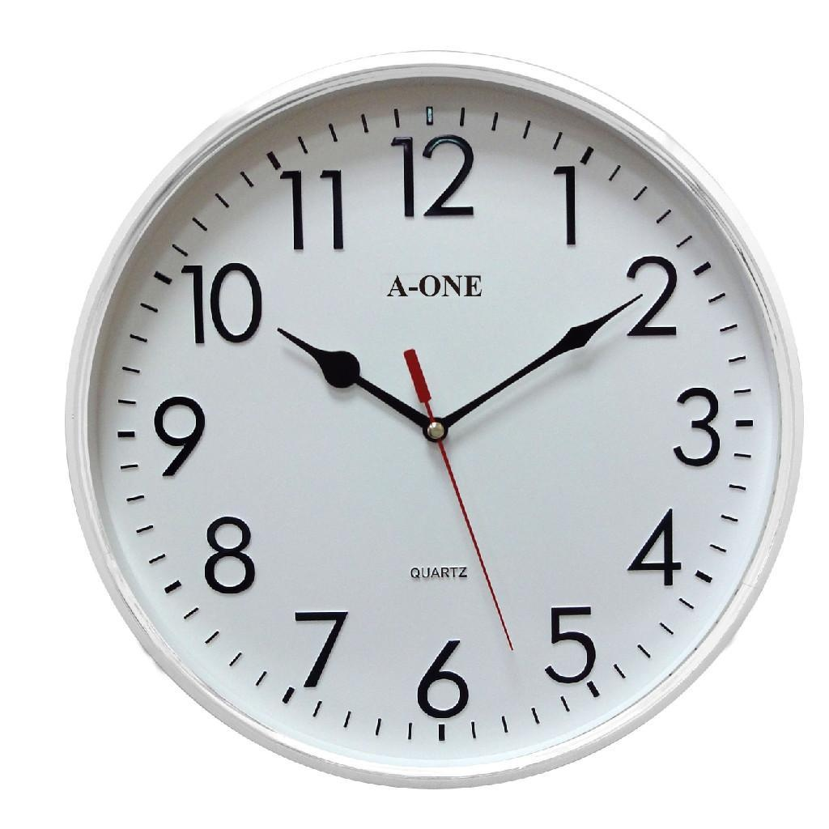
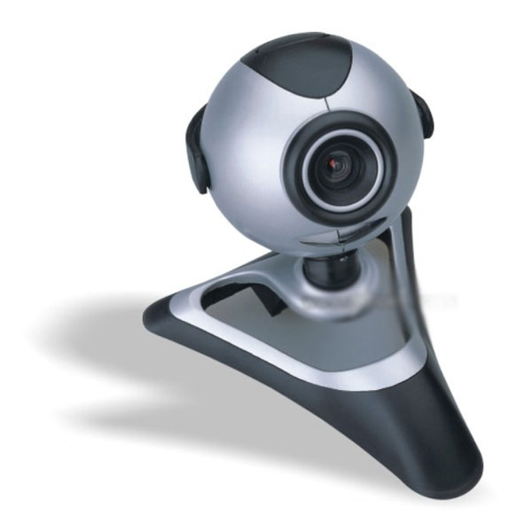
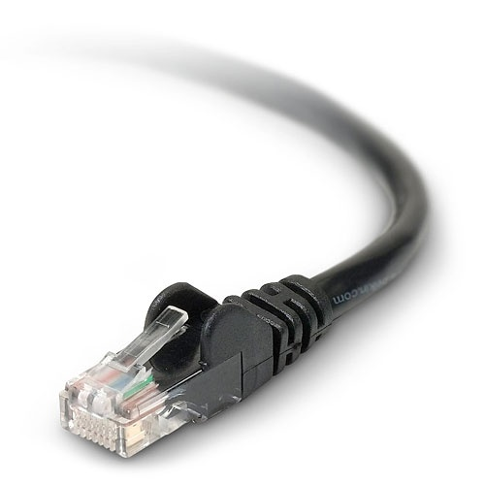
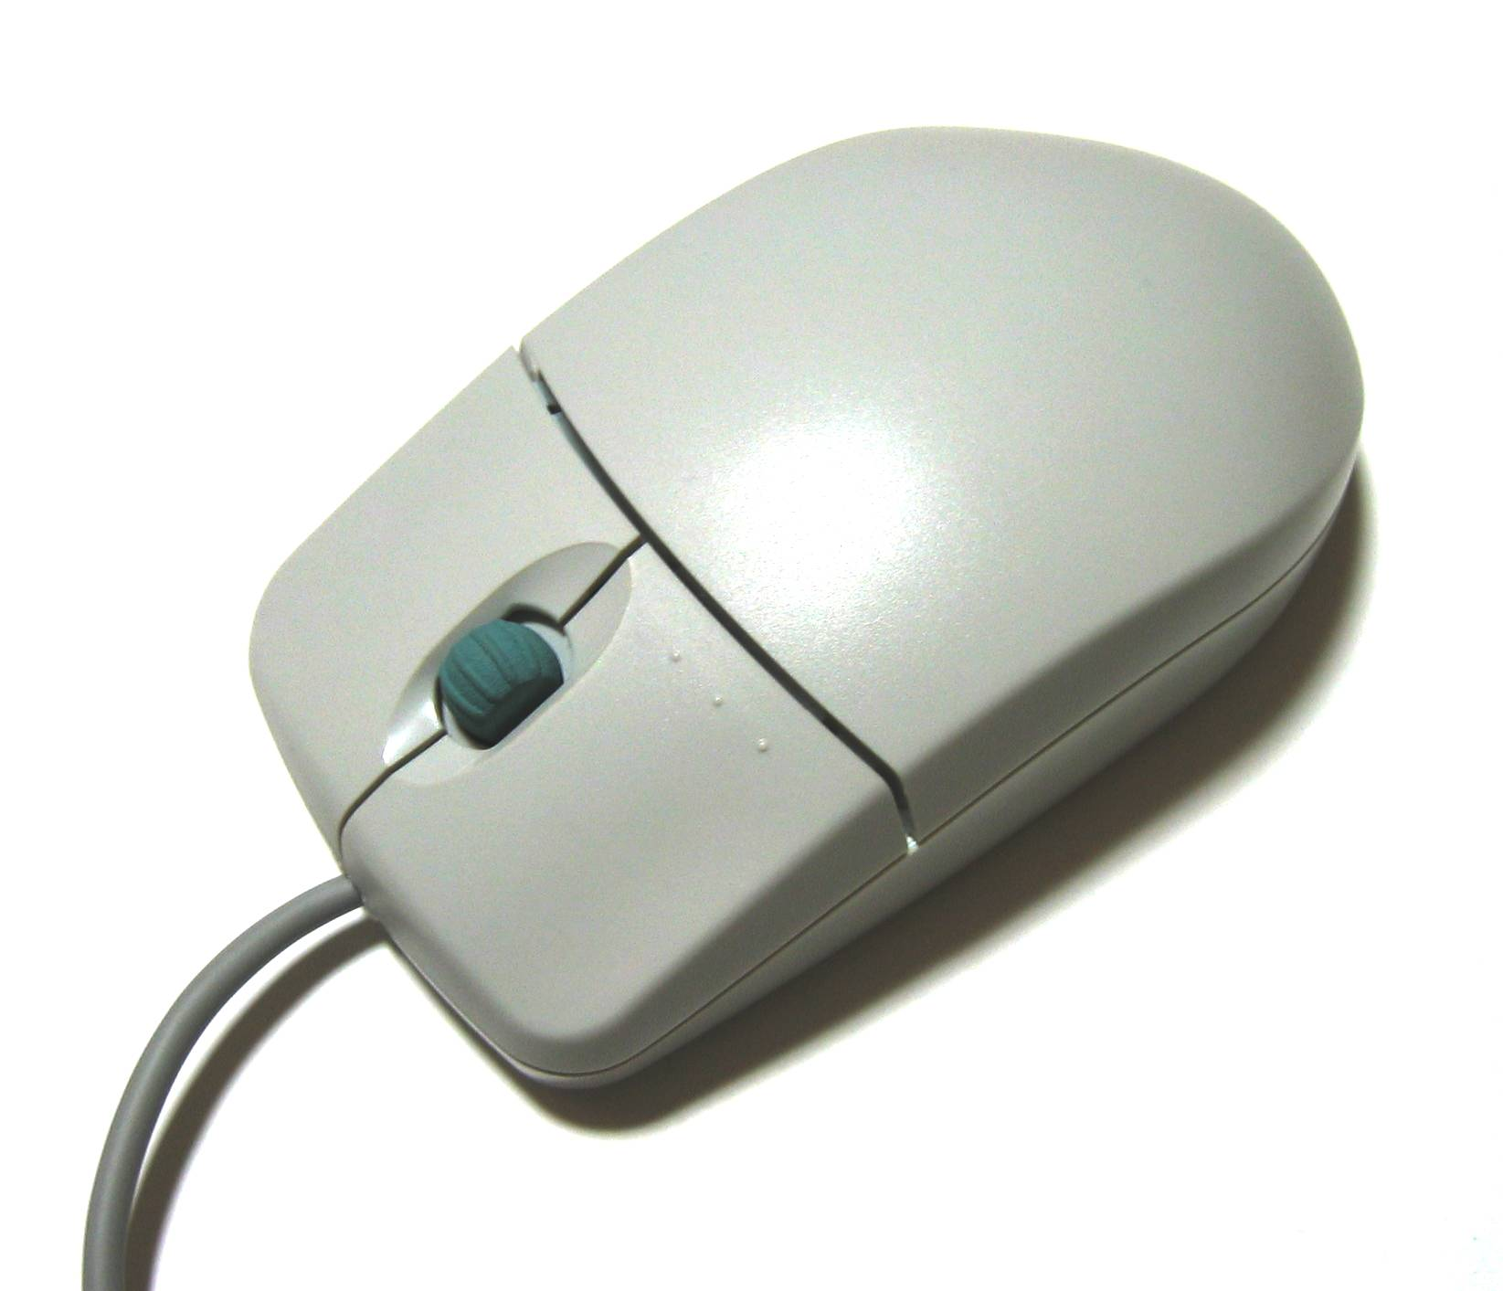
Sources of nondeterminism

Slide 5

Record inputs

Slide 6
Replay execution

Slide 7
“Old idea”
PinPlay
ReVirt
Nirvana
Jockey
ReSpec
Chronomancer
ODR
PANDA
Scribe
Echo
CLAP
FlashBack
QuickRec
ReTrace

Slide 8
rr goals
Easy to deploy: stock hardware, OS
Low overhead
Works on Firefox
Small investment

Slide 9
rr design
System call results
Signals
Record and replay
Deterministic user-space
CPU execution
Linux process boundary
Observable effects

Slide 10
No code instrumentation
mov EDX, tls.ebp
mov ECX, tls
call MemReadCallback
mov EAX, [EDX]

Slide 11
Use modern HW/OS features
System call results | ptrace
Signals | ptrace
Shared memory data races | Limit to single core
Asynchronous event timing | HW performance counters
Trap on a subset of system calls | seccomp-bpf
Notification when system call blocks in the kernel | DESCHED perf events
Cheap block copies | FIOCLONERANGE

Slide 12
ptrace
rr
before_syscall
Kernel read()
after_syscall
... record results ...

Slide 13
Use modern HW/OS features
System call results | ptrace
Signals | ptrace
Shared memory data races | Limit to single core
Asynchronous event timing | HW performance counters
Trap on a subset of system calls | seccomp-bpf
Notification when system call blocks in the kernel | DESCHED perf events
Cheap block copies | FIOCLONERANGE

Slide 14
Data races
CPU0
CPU1
Memory

Slide 15
Data races
CPU0

Slide 16
Use modern HW/OS features
System call results | ptrace
Signals | ptrace
Shared memory data races | Limit to single core
Asynchronous event timing | HW performance counters
Trap on a subset of system calls | seccomp-bpf
Notification when system call blocks in the kernel | DESCHED perf events
Cheap block copies | FIOCLONERANGE

Slide 17
Event timing: HW perf counters
alarm()
Measure progress
Instructions executed!
Instructions executed!
Retired conditional branches (Intel)
SIGALRM
Zero overhead

Slide 18
Use modern HW/OS features
System call results | ptrace
Signals | ptrace
Shared memory data races | Limit to single core
Asynchronous event timing | HW performance counters
Trap on a subset of system calls | seccomp-bpf
Notification when system call blocks in the kernel | DESCHED perf events
Cheap block copies | FIOCLONERANGE

Slide 19
Accelerating system calls
rr
before_syscall
Kernel read()
after_syscall
... record results ...

Slide 20
Avoid context switches
librrpreload.so
shim_read()
Kernel read()
Suppress ptrace trap
Use seccomp-bpf
predicates
... record results ...

Slide 21
Blocking system calls
librrpreload.so
shim_read()
Kernel read()
Kernel read()
Kernel read()
Blocks?
... record results ...

Slide 22
Blocking system calls
thread 1
read()
...
rr
kernel
DESCHED perf event
thread 2

Slide 23
Other issues
RDTSC
CPUID
RDRAND
XBEGIN/XEND

Slide 24
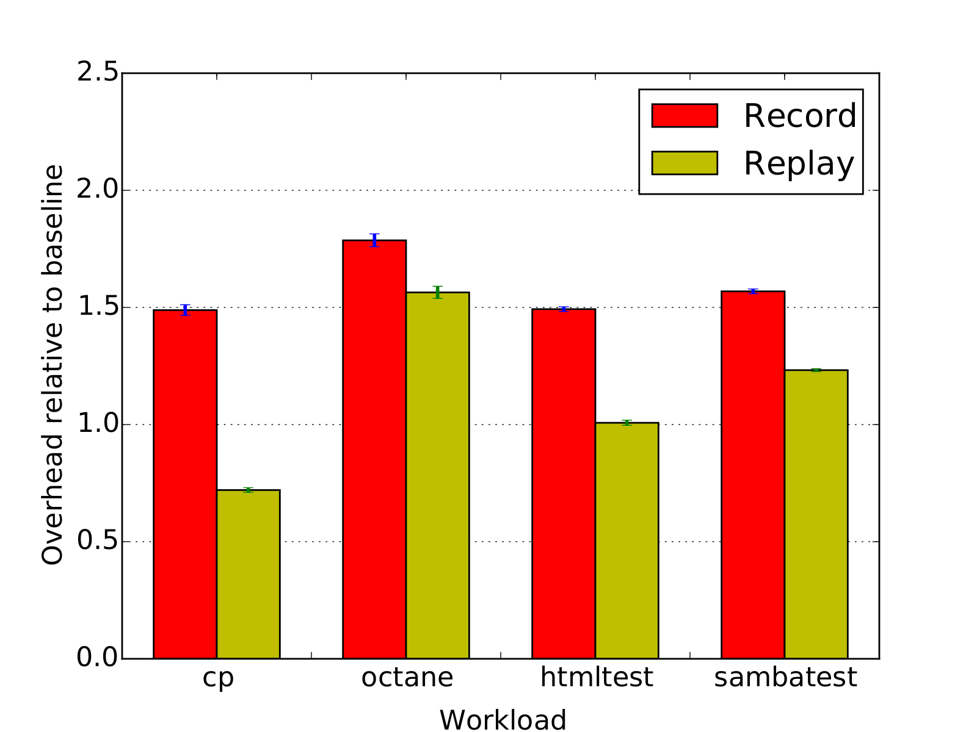
rr Overhead

Slide 25
Debug with gdb

Slide 26
Running debuggee code
(gdb) call ::DumpJSStack()
0 _setMaxHeight()
["panelUI.xml":331]
this = [object XULElement]
1 handleEvent(aEvent = [object MouseEvent])
["panelUI.xml":304]
this = [object XULElement]

Slide 27
Running debuggee code
replay
diversion clone
breakpoint
resume
::DumpJSStack()
X

Slide 28
Reverse execution
(gdb) watch -l mRect.width
(gdb) reverse-continue
nsIFrame::SetRect (this=0x2aaadd7dbeb0, aRect=...)
718 mRect = aRect;
(gdb) reverse-next

Slide 29
Reverse execution
replay
Watchpoint hit
Watchpoint hit

Slide 30
Results
21:38 mstange roc: there's somewhat of a competition going on here at the office about who can use rr the most
21:38 mstange roc: it's so good
21:39 roc :-)
21:39 roc who's using it?
21:39 mstange roc: jeff, myself, jeff's interns
21:40 mstange roc: and we're telling everybody else to use it whenever we get the chance

Slide 31
Limitations

Slide 32
Single-core
Recording/replaying inter-core data races → need HW support :-(
→ need users, to make economic argument
Find bugs in parallel programs
→ evil scheduler (chaos mode)

Slide 33
ARM
retry:
LDREX r0,[addr]
ADD r0,1
hardware interrupt???
STREX r1,r0,[addr]
CMP r1,0
BNE retry
→ Need hardware support to detect/compensate
→ Or binary rewriting

Slide 34
Kernel semantics
ioctls
Edge cases in system calls
Overhead of switching to supervisor process between each tracee context switch
→ Build into OS/hypervisor???

Slide 35
gdb
Not the ultimate debugger interface

Slide 39
static uint8_t dr_reg_to_scratch_mask(reg_id_t reg) {
if (reg >= DR_REG_R8 && reg <= DR_REG_R11) {
return 1 << (reg - DR_REG_R8);
}
if (reg >= DR_REG_R8D && reg <= DR_REG_R11D) {
return 1 << (reg - DR_REG_R8D);
}
if (reg >= DR_REG_R8W && reg <= DR_REG_R11W) {
return 1 << (reg - DR_REG_R8W);
}
if (reg >= DR_REG_R8L && reg <= DR_REG_R11L) {
return 1 << (reg - DR_REG_R8L);
}
return 0;
}

Slide 40
Debugging →
data analysis and visualization!

Slide 41
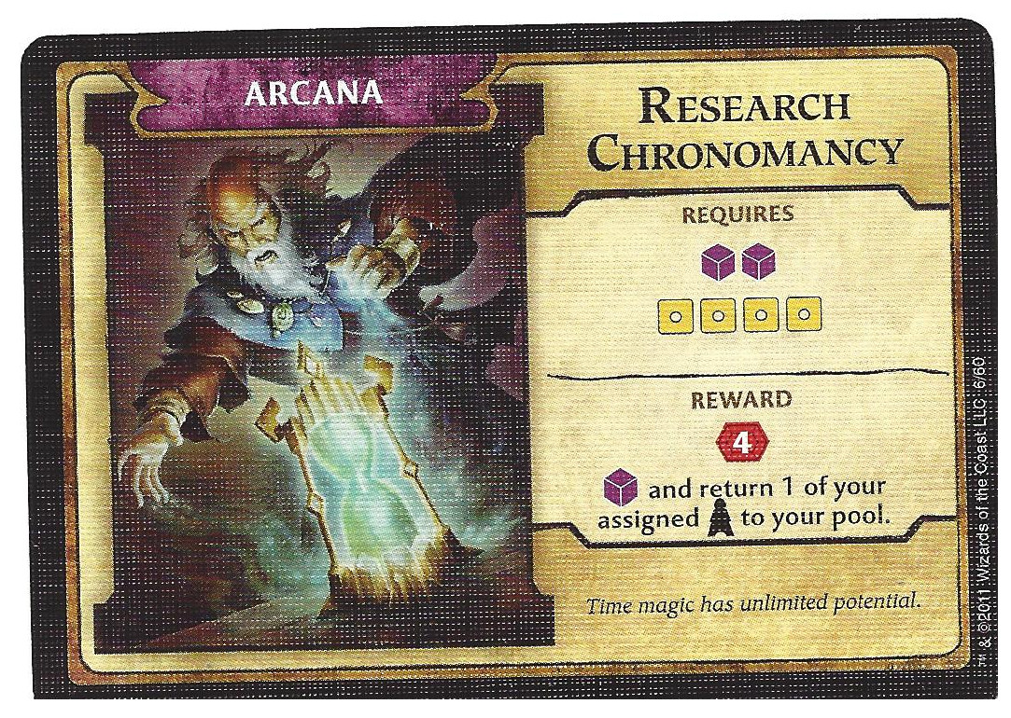
http://rr-project.org https://github.com/mozilla/rr

